Slide 1
Chapter 6 - Methods
Outline
6.1 Introduction
6.2 Program Modules in Java
6.3 Math Class Methods
6.4 Methods
6.5 Method Definitions
6.6 Argument Promotion
6.7 Java API Packages
6.8 Random-Number Generation
6.9 Example: A Game of Chance
6.10 Duration of Identifiers
6.11 Scope Rules
6.12 Recursion
6.13 Example Using Recursion: The Fibonacci Series
6.14 Recursion vs. Iteration
6.15 Method Overloading
6.16 Methods of Class JApplet
6.17 (Optional Case Study) Thinking About Objects: Identifying Class Operations

Slide 2
6.1 Introduction
Modules
  Small pieces of a problem
    e.g., divide and conquer
  Facilitate design, implementation, operation and maintenance of large programs

Slide 3
6.2 Program Modules in Java
Modules in Java
  Methods
  Classes
Java API provides several modules
Programmers can also create modules
  e.g., programmer-defined methods
Methods
  Invoked by a method call
  Returns a result to calling method (caller)
  Similar to a boss (caller) asking a worker (called method) to complete a task

Slide 4
main
worker1
worker2
worker3
worker4
worker5
Fig. 6.1 Hierarchical boss-method/worker-method relationship.

Slide 5
6.3 Math Class Methods
Class java.lang.Math
  Provides common mathematical calculations
  Calculate the square root of 900.0:
    Math.sqrt( 900.0 )
      Method sqrt belongs to class Math
        Dot operator (.) allows access to method sqrt
      The argument 900.0 is located inside parentheses

Slide 6
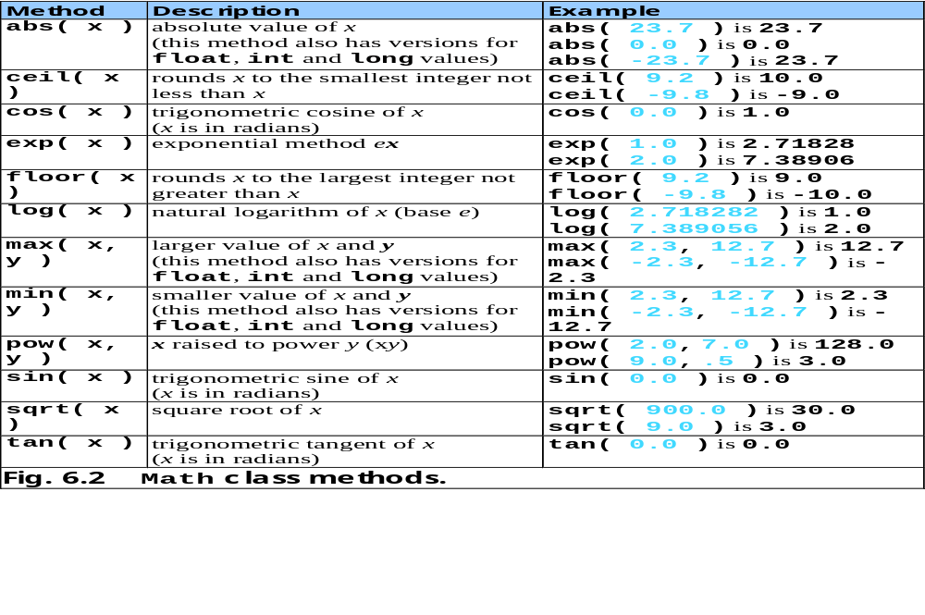

Slide 7
6.4 Methods
Methods
  Allow programmers to modularize programs
    Makes program development more manageable
    Software reusability
    Avoid repeating code
  Local variables
    Declared in method definition
  Parameters
    Communicates information between methods via method calls

Slide 8
6.5 Method Definitions
Programmers can write customized methods

Slide 9
SquareIntegers.java
Line 24
Declare result to store square of number
Line 31
Method init invokes method square
Line 31
Method square returns int that result stores
1 // Fig. 6.3: SquareIntegers.java
2 // A programmer-defined square method
3
4 // Java core packages
5 import java.awt.Container;
6
7 // Java extension packages
8 import javax.swing.*;
9
10 public class SquareIntegers extends JApplet {
11
12 // set up GUI and calculate squares of integers from 1 to 10
13 public void init()
14 {
15 // JTextArea to display results
16 JTextArea outputArea = new JTextArea();
17
18 // get applet's content pane (GUI component display area)
19 Container container = getContentPane();
20
21 // attach outputArea to container
22 container.add( outputArea );
23
24 int result; // store result of call to method square
25 String output = ""; // String containing results
26
27 // loop 10 times
28 for ( int counter = 1; counter <= 10; counter++ ) {
29
30 // calculate square of counter and store in result
31 result = square( counter );
32
33 // append result to String output
34 output += "The square of " + counter +
35 " is " + result + "\n";
Declare result to store square of number
Method init invokes method square (next slide)
Method square returns int that result stores

Slide 10
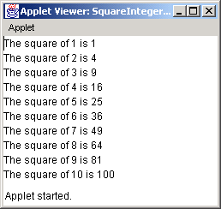
SquareIntegers.java
Line 44 y is the parameter of method square
Line 46
Method square returns the square of y
36
37 } // end for structure
38
39 outputArea.setText( output ); // place results in JTextArea
40
41 } // end method init
42
43 // square method definition
44 public int square( int y )
45 {
46 return y * y; // return square of y
47
48 } // end method square
49
50 } // end class SquareIntegers
y is the parameter of method square
Method square returns the square of y

Slide 11
6.5 Method Definitions (cont.)
General format of method:
return-value-type method-name( parameter-list )
{
declarations and statements
}
Method can also return values:
return expression;

Slide 12
Maximum.java
Lines 16-21
User inputs three Strings
Lines 24-26
Convert Strings to doubles
Line 29
Method init passes doubles as arguments to method maximum
1 // Fig. 6.4: Maximum.java
2 // Finding the maximum of three doubles
3
4 // Java core packages
5 import java.awt.Container;
6
7 // Java extension packages
8 import javax.swing.*;
9
10 public class Maximum extends JApplet {
11
12 // initialize applet by obtaining user input and creating GUI
13 public void init()
14 {
15 // obtain user input
16 String s1 = JOptionPane.showInputDialog(
17 "Enter first floating-point value" );
18 String s2 = JOptionPane.showInputDialog(
19 "Enter second floating-point value" );
20 String s3 = JOptionPane.showInputDialog(
21 "Enter third floating-point value" );
22
23 // convert user input to double values
24 double number1 = Double.parseDouble( s1 );
25 double number2 = Double.parseDouble( s2 );
26 double number3 = Double.parseDouble( s3 );
27
28 // call method maximum to determine largest value
29 double max = maximum( number1, number2, number3 );
30
31 // create JTextArea to display results
32 JTextArea outputArea = new JTextArea();
33
User inputs three Strings
Convert Strings to doubles
Method init passes doubles as arguments to method maximum

Slide 13
Maximum.java
Line 51
Method maximum returns value from method max of class Math
34 // display numbers and maximum value
35 outputArea.setText( "number1: " + number1 +
36 "\nnumber2: " + number2 + "\nnumber3: " + number3 +
37 "\nmaximum is: " + max );
38
39 // get the applet's GUI component display area
40 Container container = getContentPane();
41
42 // attach outputArea to Container c
43 container.add( outputArea );
44
45 } // end method init
46
47 // maximum method uses Math class method max to help
48 // determine maximum value
49 public double maximum( double x, double y, double z )
50 {
51 return Math.max( x, Math.max( y, z ) );
52
53 } // end method maximum
54
55 } // end class Maximum
Method maximum returns value from method max of class Math

Slide 14
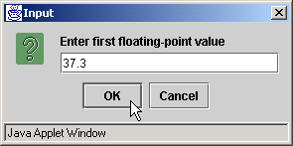
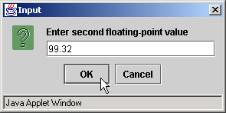
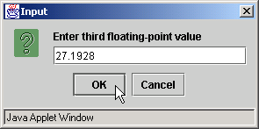
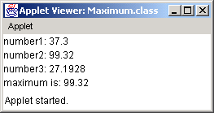
Maximum.java

Slide 15
6.6 Argument Promotion
Coercion of arguments
  Forcing arguments to appropriate type to pass to method
    e.g., System.out.println( Math.sqrt( 4 ) );
      Evaluates Math.sqrt( 4 )
      Then evaluates System.out.println()
Promotion rules
  Specify how to convert types without data loss

Slide 16
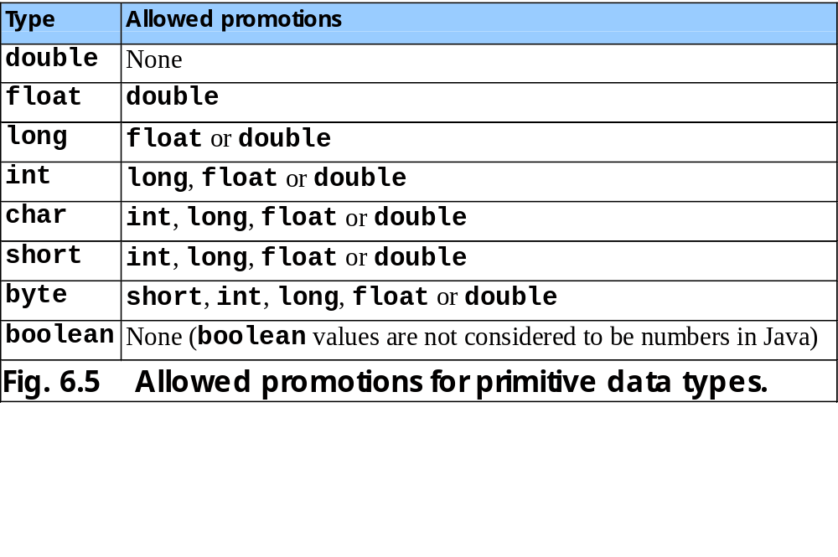

Slide 17
6.7 Java API Packages
Packages
  Classes grouped into categories of related classes
  Promotes software reuse
  import statements specify classes used in Java programs
    e.g., import javax.swing.JApplet;

Slide 18
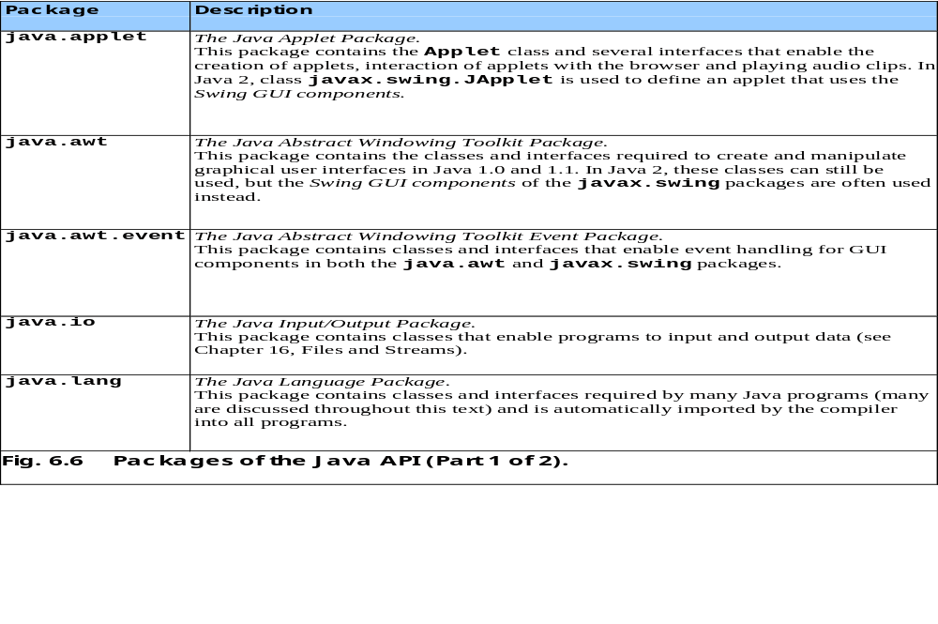

Slide 19
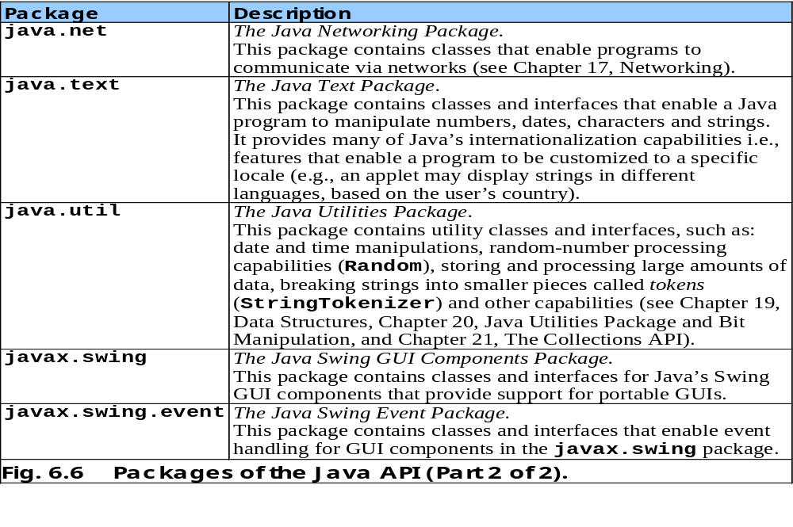

Slide 20
6.8 Random-Number Generation
Java random-number generators
  Math.random()
    ( int ) ( Math.random() * 6 )
      Produces integers from 0 - 5
  Use a seed for different random-number sequences

Slide 21
RandomIntegers.java
Line 19
Produce integers in range 1-6
Line 19
Math.random returns doubles. We cast the double as an int
1 // Fig. 6.7: RandomIntegers.java
2 // Shifted, scaled random integers.
3
4 // Java extension packages
5 import javax.swing.JOptionPane;
6
7 public class RandomIntegers {
8
9 // main method begins execution of Java application
10 public static void main( String args[] )
11 {
12 int value;
13 String output = "";
14
15 // loop 20 times
16 for ( int counter = 1; counter <= 20; counter++ ) {
17
18 // pick random integer between 1 and 6
19 value = 1 + ( int ) ( Math.random() * 6 );
20
21 output += value + " "; // append value to output
22
23 // if counter divisible by 5,
24 // append newline to String output
25 if ( counter % 5 == 0 )
26 output += "\n";
27
28 } // end for structure
29
30 JOptionPane.showMessageDialog( null, output,
31 "20 Random Numbers from 1 to 6",
32 JOptionPane.INFORMATION_MESSAGE );
33
34 System.exit( 0 ); // terminate application
35
Produce integers in range 1-6
Math.random returns doubles. We cast the double as an int

Slide 22
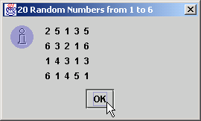
RandomIntegers.java
36 } // end method main
37
38 } // end class RandomIntegers

Slide 23
RollDie.java
Line 17
Produce integers in range 1-6
Line 20
Increment appropriate frequency counter, depending on randomly generated number
1 // Fig. 6.8: RollDie.java
2 // Roll a six-sided die 6000 times.
3
4 // Java extension packages
5 import javax.swing.*;
6
7 public class RollDie {
8
9 // main method begins execution of Java application
10 public static void main( String args[] )
11 {
12 int frequency1 = 0, frequency2 = 0, frequency3 = 0,
13 frequency4 = 0, frequency5 = 0, frequency6 = 0, face;
14
15 // summarize results
16 for ( int roll = 1; roll <= 6000; roll++ ) {
17 face = 1 + ( int ) ( Math.random() * 6 );
18
19 // determine roll value and increment appropriate counter
20 switch ( face ) {
21
22 case 1:
23 ++frequency1;
24 break;
25
26 case 2:
27 ++frequency2;
28 break;
29
30 case 3:
31 ++frequency3;
32 break;
33
Produce integers in range 1-6
Increment appropriate frequency counter, depending on randomly generated number

Slide 24
RollDie.java
34 case 4:
35 ++frequency4;
36 break;
37
38 case 5:
39 ++frequency5;
40 break;
41
42 case 6:
43 ++frequency6;
44 break;
45
46 } // end switch structure
47
48 } // end for structure
49
50 JTextArea outputArea = new JTextArea();
51
52 outputArea.setText( "Face\tFrequency" +
53 "\n1\t" + frequency1 + "\n2\t" + frequency2 +
54 "\n3\t" + frequency3 + "\n4\t" + frequency4 +
55 "\n5\t" + frequency5 + "\n6\t" + frequency6 );
56
57 JOptionPane.showMessageDialog( null, outputArea,
58 "Rolling a Die 6000 Times",
59 JOptionPane.INFORMATION_MESSAGE );
60
61 System.exit( 0 ); // terminate application
62
63 } // end method main
64
65 } // end class RollDie

Slide 25
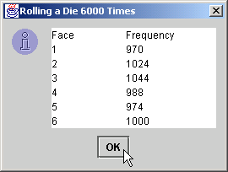
RollDie.java

Slide 26
6.9 Example: A Game of Chance
Craps simulation
  Roll dice first time
    If sum equals 7 or 11, the player wins
    If sum equals 2, 3 or 12, the player loses
    Any other sum (4, 5, 6, 8, 9, 10) is that player’s point
  Keep rolling dice until…
    Sum matches player point
      Player wins
    Sum equals 7 or 11
      Player loses

Slide 27
Craps.java
Line 28
Method init starts JApplet and initializes GUI
1 // Fig. 6.9: Craps.java
2 // Craps
3
4 // Java core packages
5 import java.awt.*;
6 import java.awt.event.*;
7
8 // Java extension packages
9 import javax.swing.*;
10
11 public class Craps extends JApplet implements ActionListener {
12
13 // constant variables for game status
14 final int WON = 0, LOST = 1, CONTINUE = 2;
15
16 // other variables used
17 boolean firstRoll = true; // true if first roll of dice
18 int sumOfDice = 0; // sum of the dice
19 int myPoint = 0; // point if no win/loss on first roll
20 int gameStatus = CONTINUE; // game not over yet
21
22 // graphical user interface components
23 JLabel die1Label, die2Label, sumLabel, pointLabel;
24 JTextField die1Field, die2Field, sumField, pointField;
25 JButton rollButton;
26
27 // set up GUI components
28 public void init()
29 {
30 // obtain content pane and change its layout to
31 // a FlowLayout
32 Container container = getContentPane();
33 container.setLayout( new FlowLayout() );
34
Method init starts JApplet and initializes GUI (Chapter 12 covers GUI in detail)

Slide 28
Craps.java
Lines 38 and 45
JTextFields that output dice results
Line 52
JTextField that outputs sum of dice
Line 59
JTextField that outputs player’s point
Line 64
JButton for rolling dice
35 // create label and text field for die 1
36 die1Label = new JLabel( "Die 1" );
37 container.add( die1Label );
38 die1Field = new JTextField( 10 );
39 die1Field.setEditable( false );
40 container.add( die1Field );
41
42 // create label and text field for die 2
43 die2Label = new JLabel( "Die 2" );
44 container.add( die2Label );
45 die2Field = new JTextField( 10 );
46 die2Field.setEditable( false );
47 container.add( die2Field );
48
49 // create label and text field for sum
50 sumLabel = new JLabel( "Sum is" );
51 container.add( sumLabel );
52 sumField = new JTextField( 10 );
53 sumField.setEditable( false );
54 container.add( sumField );
55
56 // create label and text field for point
57 pointLabel = new JLabel( "Point is" );
58 container.add( pointLabel );
59 pointField = new JTextField( 10 );
60 pointField.setEditable( false );
61 container.add( pointField );
62
63 // create button user clicks to roll dice
64 rollButton = new JButton( "Roll Dice" );
65 rollButton.addActionListener( this );
66 container.add( rollButton );
67 }
68
JTextFields that output dice results
JTextField that outputs sum of dice
JTextField that outputs player’s point
JButton for rolling dice

Slide 29
Craps.java
Line 70
Method invoked when user presses JButton
Lines 73-74
If first roll, invoke method rollDice
Lines 79-82
If sum is 7 or 11, user wins
Lines 85-88
If sum is 2, 3 or 12, user loses
Lines 91-96
If sum is 4, 5, 6, 8, 9 or 10, that sum is the point
69 // process one roll of dice
70 public void actionPerformed( ActionEvent actionEvent )
71 {
72 // first roll of dice
73 if ( firstRoll ) {
74 sumOfDice = rollDice(); // roll dice
75
76 switch ( sumOfDice ) {
77
78 // win on first roll
79 case 7: case 11:
80 gameStatus = WON;
81 pointField.setText( "" ); // clear point field
82 break;
83
84 // lose on first roll
85 case 2: case 3: case 12:
86 gameStatus = LOST;
87 pointField.setText( "" ); // clear point field
88 break;
89
90 // remember point
91 default:
92 gameStatus = CONTINUE;
93 myPoint = sumOfDice;
94 pointField.setText( Integer.toString( myPoint ) );
95 firstRoll = false;
96 break;
97
98 } // end switch structure
99
100 } // end if structure body
101
Method invoked when user presses JButton
If first roll, invoke method rollDice
If sum is 7 or 11, user wins
If user rolls 2, 3 or 12, user loses
If sum is 4, 5, 6, 8, 9 or 10, that sum is the point

Slide 30
Craps.java
Line 104
If subsequent roll, invoke method rollDice
Lines 107-111
If sum equals point, user wins; If sum equals 7, user loses
Lines 125-126
Method rollDice uses Math.random to simulate rolling two dice
Line 135 return dice sum
102 // subsequent roll of dice
103 else {
104 sumOfDice = rollDice(); // roll dice
105
106 // determine game status
107 if ( sumOfDice == myPoint ) // win by making point
108 gameStatus = WON;
109 else
110 if ( sumOfDice == 7 ) // lose by rolling 7
111 gameStatus = LOST;
112 }
113
114 // display message indicating game status
115 displayMessage();
116
117 } // end method actionPerformed
118
119 // roll dice, calculate sum and display results
120 public int rollDice()
121 {
122 int die1, die2, sum;
123
124 // pick random die values
125 die1 = 1 + ( int ) ( Math.random() * 6 );
126 die2 = 1 + ( int ) ( Math.random() * 6 );
127
128 sum = die1 + die2; // sum die values
129
130 // display results
131 die1Field.setText( Integer.toString( die1 ) );
132 die2Field.setText( Integer.toString( die2 ) );
133 sumField.setText( Integer.toString( sum ) );
134
135 return sum; // return sum of dice
136
If subsequent roll, invoke method rollDice
If sum equals point, user wins; If sum equals 7, user loses
Method rollDice uses Math.random to simulate rolling two dice
return dice sum

Slide 31
Craps.java
137 } // end method rollDice
138
139 // determine game status and display appropriate message
140 // in status bar
141 public void displayMessage()
142 {
143 // game should continue
144 if ( gameStatus == CONTINUE )
145 showStatus( "Roll again." );
146
147 // game won or lost
148 else {
149
150 if ( gameStatus == WON )
151 showStatus( "Player wins. " +
152 "Click Roll Dice to play again." );
153 else
154 showStatus( "Player loses. " +
155 "Click Roll Dice to play again." );
156
157 // next roll is first roll of new game
158 firstRoll = true;
159 }
160
161 } // end method displayMessage
162
163 } // end class Craps

Slide 32
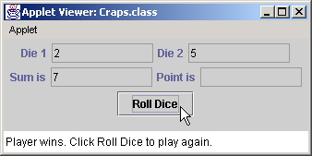
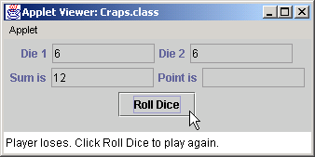
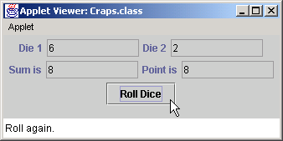
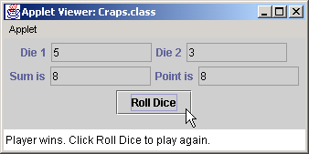

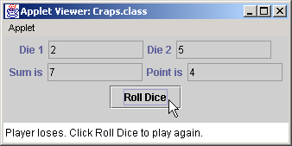
Craps.java

Slide 33
6.10 Duration of Identifiers
Identifier duration
  Lifetime
    Period during which identifier exists in memory
  Automatic duration
    Local variables
  Static duration
Identifier scope
  Defines where identifier can be referenced

Slide 34
6.11 Scope Rules
Scope
  Portion of the program that can reference an identifier
  Class scope
    Begins at opening brace ({) and ends at closing brace (})
    e.g., methods and instance variables
  Block scope
    Begins at identifier declaration and ends at closing brace (})
    e.g., local variables and method parameters

Slide 35
Scoping.java
Line 14
Instance variable x has class scope
Line 29
Local variable x has block scope
Line 31
Method start uses local variable x
1 // Fig. 6.10: Scoping.java
2 // A scoping example.
3
4 // Java core packages
5 import java.awt.Container;
6
7 // Java extension packages
8 import javax.swing.*;
9
10 public class Scoping extends JApplet {
11 JTextArea outputArea;
12
13 // instance variable accessible to all methods of this class
14 int x = 1;
15
16 // set up applet’s GUI
17 public void init()
18 {
19 outputArea = new JTextArea();
20 Container container = getContentPane();
21 container.add( outputArea );
22
23 } // end method init
24
25 // method start called after init completes; start calls
26 // methods useLocal and useInstance
27 public void start()
28 {
29 int x = 5; // variable local to method start
30
31 outputArea.append( "local x in start is " + x );
32
33 useLocal(); // useLocal has local x
34 useInstance(); // useInstance uses instance variable x
Instance variable x has class scope
Local variable x has block scope
Method start uses local variable x

Slide 36
Scoping.java
Line 45
A second variable x has block scope
Lines 47-51
Method useLocal uses local variable x
Lines 58-62
Method use-Instance uses instance variable x
35 useLocal(); // useLocal reinitializes local x
36 useInstance(); // instance variable x retains its value
37
38 outputArea.append( "\n\nlocal x in start is " + x );
39
40 } // end method start
41
42 // useLocal reinitializes local variable x during each call
43 public void useLocal()
44 {
45 int x = 25; // initialized each time useLocal is called
46
47 outputArea.append( "\n\nlocal x in useLocal is " + x +
48 " after entering useLocal" );
49 ++x;
50 outputArea.append( "\nlocal x in useLocal is " + x +
51 " before exiting useLocal" );
52
53 } // end method useLocal
54
55 // useInstance modifies instance variable x during each call
56 public void useInstance()
57 {
58 outputArea.append( "\n\ninstance variable x is " + x +
59 " on entering useInstance" );
60 x *= 10;
61 outputArea.append( "\ninstance variable x is " + x +
62 " on exiting useInstance" );
63
64 } // end method useInstance
65
66 } // end class Scoping
A second variable x has block scope
Method useLocal uses local variable x
Method useInstance uses instance variable x

Slide 37
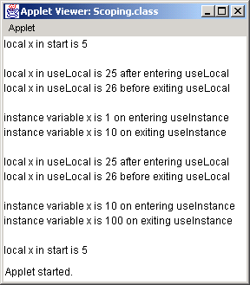
Scoping.java

Slide 38
6.12 Recursion
Recursive method
  Calls itself (directly or indirectly) through another method
  Method knows how to solve only a base case
  Method divides problem
    Base case
    Simpler problem
      Method now divides simpler problem until solvable
  Recursive call
  Recursive step

Slide 39
Final value = 120
5!
5!
5! = 5 * 24 = 120 is returned
5 * 4!
5 * 4!
4! = 4 * 6 = 24 is returned
4 * 3!
4 * 3!
3! = 3 * 2 = 6 is returned
3 * 2!
3 * 2!
2! = 2 * 1 = 2 is returned
2 * 1!
2 * 1!
1 returned
1
1
(a) Procession of recursive calls.
(b) Values returned from each recursive call.
Fig. 6.11 Recursive evaluation of 5!.

Slide 40
FactorialTest.java
Line 24
Invoke method factorial
Lines 32-33
Test for base case (method factorial can solve base case)
1 // Fig. 6.12: FactorialTest.java
2 // Recursive factorial method
3
4 // Java core packages
5 import java.awt.*;
6
7 // Java extension packages
8 import javax.swing.*;
9
10 public class FactorialTest extends JApplet {
11 JTextArea outputArea;
12
13 // initialize applet by creating GUI and calculating factorials
14 public void init()
15 {
16 outputArea = new JTextArea();
17
18 Container container = getContentPane();
19 container.add( outputArea );
20
21 // calculate the factorials of 0 through 10
22 for ( long counter = 0; counter <= 10; counter++ )
23 outputArea.append( counter + "! = " +
24 factorial( counter ) + "\n" );
25
26 } // end method init
27
28 // Recursive definition of method factorial
29 public long factorial( long number )
30 {
31 // base case
32 if ( number <= 1 )
33 return 1;
34
Invoke method factorial
Test for base case (method factorial can solve base case)

Slide 41
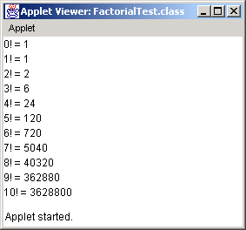
FactorialTest.java
Line 37
Else return simpler problem that method factorial might solve in next recursive call
35 // recursive step
36 else
37 return number * factorial( number - 1 );
38
39 } // end method factorial
40
41 } // end class FactorialTest
Else return simpler problem that method factorial might solve in next recursive call

Slide 42
6.13 Example Using Recursion: The Fibonacci Series
Fibonacci series
  Each number in the series is sum of two previous numbers
    e.g., 0, 1, 1, 2, 3, 5, 8, 13, 21…
    fibonacci(0) = 0
    fibonacci(1) = 1
    fibonacci(n) = fibonacci(n - 1) + fibonacci( n – 1 )
    fibonacci(0) and fibonacci(1) are base cases
  Golden ratio (golden mean)

Slide 43
FibonacciTest.java
1 // Fig. 6.13: FibonacciTest.java
2 // Recursive fibonacci method
3
4 // Java core packages
5 import java.awt.*;
6 import java.awt.event.*;
7
8 // Java extension packages
9 import javax.swing.*;
10
11 public class FibonacciTest extends JApplet
12 implements ActionListener {
13
14 JLabel numberLabel, resultLabel;
15 JTextField numberField, resultField;
16
17 // set up applet’s GUI
18 public void init()
19 {
20 // obtain content pane and set its layout to FlowLayout
21 Container container = getContentPane();
22 container.setLayout( new FlowLayout() );
23
24 // create numberLabel and attach it to content pane
25 numberLabel =
26 new JLabel( "Enter an integer and press Enter" );
27 container.add( numberLabel );
28
29 // create numberField and attach it to content pane
30 numberField = new JTextField( 10 );
31 container.add( numberField );
32
33 // register this applet as numberField’s ActionListener
34 numberField.addActionListener( this );
35

Slide 44
FibonacciTest.java
Line 49
Method actionPerformed is invoked when user presses Enter
Line 51
We use long, because Fibonacci numbers become large quickly
Lines 54-59
Pass user input to method fibonacci
36 // create resultLabel and attach it to content pane
37 resultLabel = new JLabel( "Fibonacci value is" );
38 container.add( resultLabel );
39
40 // create numberField, make it uneditable
41 // and attach it to content pane
42 resultField = new JTextField( 15 );
43 resultField.setEditable( false );
44 container.add( resultField );
45
46 } // end method init
47
48 // obtain user input and call method fibonacci
49 public void actionPerformed( ActionEvent e )
50 {
51 long number, fibonacciValue;
52
53 // obtain user’s input and conver to long
54 number = Long.parseLong( numberField.getText() );
55
56 showStatus( "Calculating ..." );
57
58 // calculate fibonacci value for number user input
59 fibonacciValue = fibonacci( number );
60
61 // indicate processing complete and display result
62 showStatus( "Done." );
63 resultField.setText( Long.toString( fibonacciValue ) );
64
65 } // end method actionPerformed
66
Method actionPerformed is invoked when user presses Enter
We use long, because Fibonacci numbers become large quickly
Pass user input to method fibonacci

Slide 45
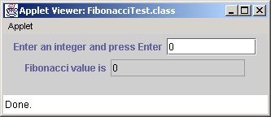
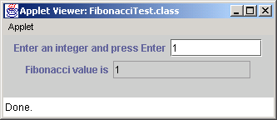


FibonacciTest.java
Lines 71-72
Test for base case (method fibonacci can solve base case)
Lines 75-76
Else return simpler problem that method fibonacci might solve in next recursive call
67 // Recursive definition of method fibonacci
68 public long fibonacci( long n )
69 {
70 // base case
71 if ( n == 0 || n == 1 )
72 return n;
73
74 // recursive step
75 else
76 return fibonacci( n - 1 ) + fibonacci( n - 2 );
77
78 } // end method fibonacci
79
80 } // end class FibonacciTest
Test for base case (method fibonacci can solve base case)
Else return simpler problem that method fibonacci might solve in next recursive call

Slide 46


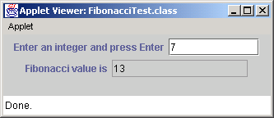
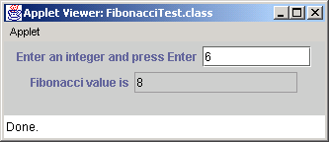
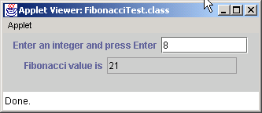
FibonacciTest.java

Slide 47


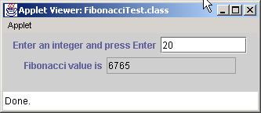
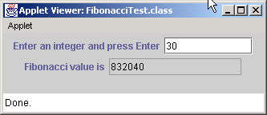
FibonacciTest.java

Slide 48
f( 3 )
return
f( 2 )
+
f( 1 )
return
f( 1 )
+
f( 0 )
return 1
return 1
return 0
Fig. 6.14 Set of recursive calls to method fibonacci (f in this diagram).

Slide 49
6.14 Recursion vs. Iteration
Iteration
  Uses repetition structures (for, while or do/while)
  Repetition through explicitly use of repetition structure
  Terminates when loop-continuation condition fails
  Controls repetition by using a counter
Recursion
  Uses selection structures (if, if/else or switch)
  Repetition through repeated method calls
  Terminates when base case is satisfied
  Controls repetition by dividing problem into simpler one

Slide 50
6.14 Recursion vs. Iteration (cont.)
Recursion
  More overhead than iteration
  More memory intensive than iteration
  Can also be solved iteratively
  Often can be implemented with only a few lines of code

Slide 51
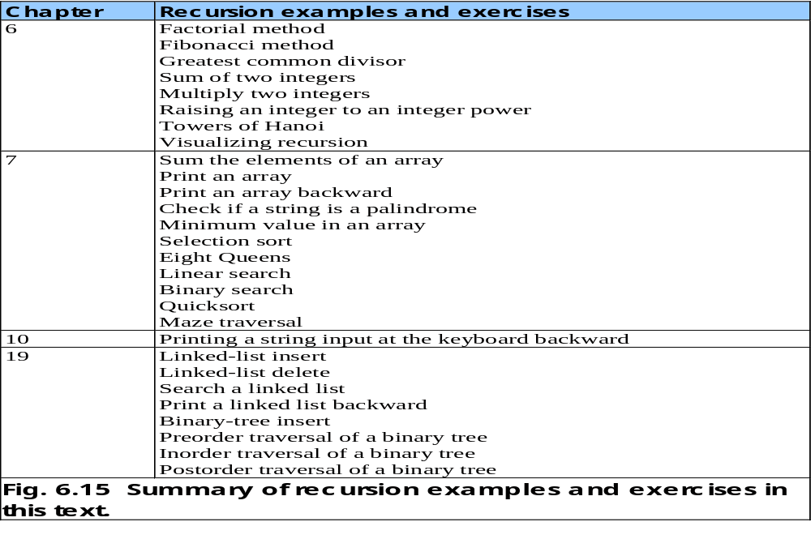

Slide 52
6.15 Method Overloading
Method overloading
  Several methods of the same name
  Different parameter set for each method
    Number of parameters
    Parameter types

Slide 53
MethodOverload.java
Lines 25-32
Method square receives an int as an argument
1 // Fig. 6.16: MethodOverload.java
2 // Using overloaded methods
3
4 // Java core packages
5 import java.awt.Container;
6
7 // Java extension packages
8 import javax.swing.*;
9
10 public class MethodOverload extends JApplet {
11
12 // set up GUI and call versions of method square
13 public void init()
14 {
15 JTextArea outputArea = new JTextArea();
16 Container container = getContentPane();
17 container.add( outputArea );
18
19 outputArea.setText(
20 "The square of integer 7 is " + square( 7 ) +
21 "\nThe square of double 7.5 is " + square( 7.5 ) );
22 }
23
24 // square method with int argument
25 public int square( int intValue )
26 {
27 System.out.println(
28 "Called square with int argument: " + intValue );
29
30 return intValue * intValue;
31
32 } // end method square with int argument
33
Method square receives an int as an argument

Slide 54
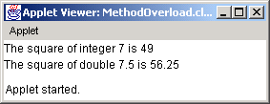
MethodOverload.java
Lines 35-42
Overloaded method square receives a double as an argument
34 // square method with double argument
35 public double square( double doubleValue )
36 {
37 System.out.println(
38 "Called square with double argument: " + doubleValue );
39
40 return doubleValue * doubleValue;
41
42 } // end method square with double argument
43
44 } // end class MethodOverload
Overloaded method square receives a double as an argument
Called square with int argument: 7
Called square with double argument: 7.5

Slide 55
MethodOverload.java
Lines 11 and 18
Compiler cannot distinguish between methods with identical names and parameter sets
Fig. 6.17 Compiler error messages generated from overloaded methods with identical parameter lists and different return types.
1 // Fig. 6.17: MethodOverload.java
2 // Overloaded methods with identical signatures and
3 // different return types.
4
5 // Java extension packages
6 import javax.swing.JApplet;
7
8 public class MethodOverload extends JApplet {
9
10 // first definition of method square with double argument
11 public int square( double x )
12 {
13 return x * x;
14 }
15
16 // second definition of method square with double argument
17 // causes syntax error
18 public double square( double y )
19 {
20 return y * y;
21 }
22
23 } // end class MethodOverload
Compiler cannot distinguish between methods with identical names and parameter sets
MethodOverload.java:18: square(double) is already defined in
MethodOverload
public double square( double y )
^
MethodOverload.java:13: possible loss of precision
found : double
required: int
return x * x;
^
2 errors

Slide 56
6.16 Methods of Class JApplet
Java API defines several JApplet methods
  Defining methods of Fig. 6.18 in a JApplet is called overriding those methods.

Slide 57
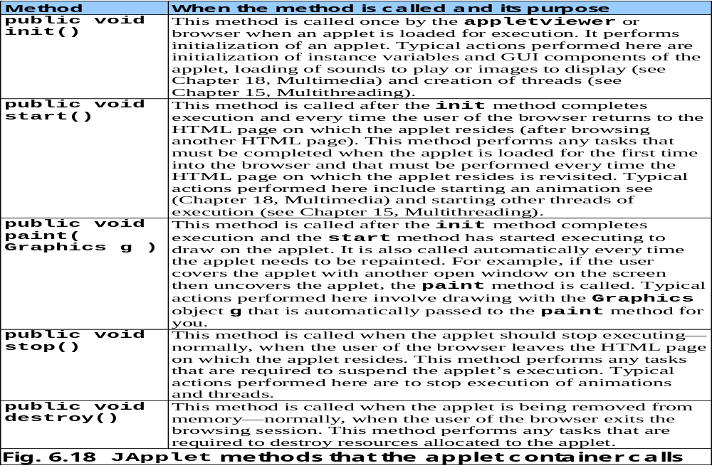

Slide 58
6.17 (Optional Case Study) Thinking About Objects: Identifying Class Operations
Class operations
  Also known as behaviors
  Service the class provides to “clients” (users) of that class
    e.g., radio’s operations
      Setting its station or volume

Slide 59
6.17 Thinking About Objects (cont.)
Deriving class operations
  Use problem statement
    Identify verbs and verb phrases
    Verbs can help determine class operations

Slide 60
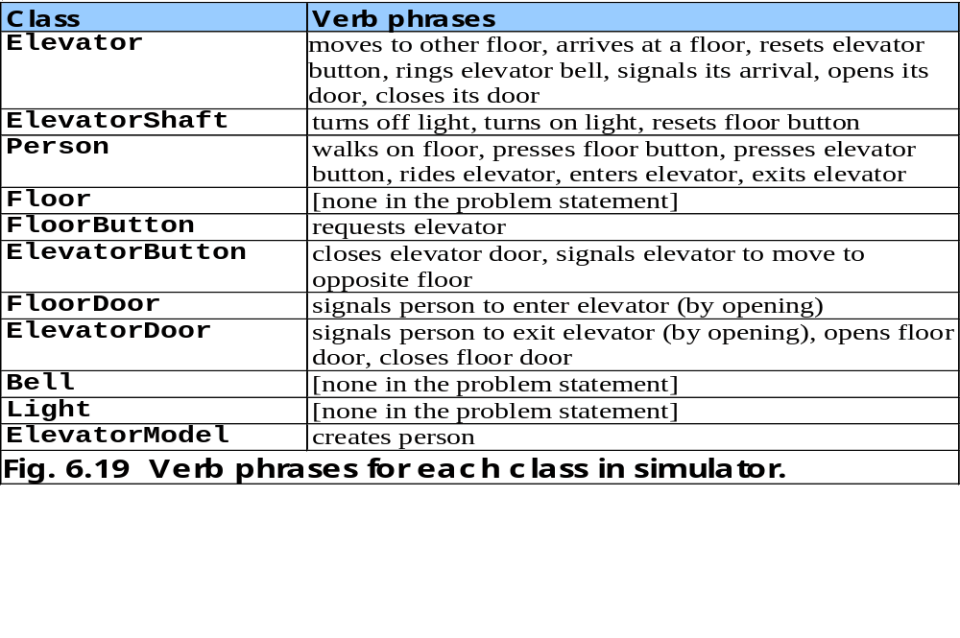

Slide 61
6.17 Thinking About Objects (cont.)
Deriving class operations
  Verbs can help determine class operations
    e.g., verb phrase “the elevator resets its button”
      Elevator informs ElevatorButton to reset
      ElevatorButton needs method resetButton
    e.g., verb phrase “the elevator opens its door”
      Elevator informs ElevatorDoor to open
      ElevatorDoor needs method openDoor

Slide 62
6.17 Thinking About Objects (cont.)
Deriving class operations
  Not all verbs determine class operations
    e.g., verb phrase “the elevator arrives at a floor”
      Elevator decides when to arrive
        (after traveling 5 seconds)
      i.e., no object causes Elevator to arrive
      Elevator does not need to provide “arrival” service for other objects
      arriveElevator is not a valid method (operation)
        We do not include method arriveElevator

Slide 63
6.17 Thinking About Objects (cont.)
Store methods (operations) in UML class diagram
  Place class methods in bottom compartment of that class

Slide 64
ElevatorModel
numberOfPeople : Integer=0
addPerson( ) : void
ElevatorShaft
<none yet>
<none yet>
ElevatorDoor
open : Boolean = false
addPerson( ) : void
Person
ID : Integer
moving : Boolean = true
doorOpened( ) : void
Floor
floorNumber : Integer
capacity : Integer = 1
<none yet>
Light
lightOn : Boolean = false
turnOnLight( ) : void
turnOffLight( ) : void
Elevator
moving : Boolean = false
summoned : Boolean = false
currentFloor : Integer = 1
destinationFloor : Integer = 2
capacity : Integer = 1
travelTime : Integer = 5
ride( ) : void
requestElevator( ) : void
enterElevator( ) : void
exitElevator( ) : void
departElevator( ) : void
ElevatorButton
pressed : Boolean = false
resetButton( ) : void
pressButton( ) : void
Bell
<none yet>
ringBell( ) : void
FloorButton
pressed : Boolean = false
resetButton( ) : void
pressButton( ) : void
ElevatorDoor
open : Boolean = false
openDoor( ) : void
closeDoor( ) : void

